Slide 1



SMART BUDGET PLANNER
(0/1 Knapsack Problem Solver)
SUBMITTED BY:
Sagar Jaswal (2330193)
Divyanshi Dadhawal (2330099)
Geetanjali shree (2330104)
Muskan kumari (2420360

Slide 2
CONTENT
1
01
BOUT - PROJECT
2
3
02
PROBLEM STATEMENT
4
03
OBJECTIVE
5
6
04
FUTURE SCOPE
7
05
FINAL RESULT

Slide 3
About - Project
1
2
TSimple & user-friendly interface
Based entirely on frontend (HTML, CSS, JS)
Educational + practical use
Inspired by real-world stock investment problems
3
4
5
6
7

Slide 4
Problem Statement
1
2
Budget allocation is often done without proper planning.
Users find it difficult to select the most valuable items under budget constraints.
Manual planning can lead to suboptimal decisions.
A smart, algorithm-based tool is needed to make the process easier and more effective.
3
4
5
6
7

Slide 5
Objective
1
To build a frontend web application for smart budget planning.
To implement the 0/1 Knapsack algorithm for optimal selection.
To help users achieve maximum value within a fixed budget.
To create a clean, interactive, and easy-to-use interface.
To demonstrate real-life use of algorithms in financial/resource planning.
2
3
4
5
6
7

Slide 6
Future Scope
1
2
Backend Integration: Add a database to store user data, previous plans, and history.
Real-Time Stock/Expense APIs: Integrate real market data to plan actual investments.
User Authentication: Allow login/signup for personalized budget tracking.
Analytics Dashboard: Show charts, graphs, and summaries of spending/investments.
Mobile App Version: Develop a cross-platform app using React Native or Flutter.
AI-Based Suggestions: Use machine learning to suggest best items based on past inputs.
Multi-Category Budgeting: Expand to handle multiple budget types (food, education, health, etc.)
3
4
5
6
7

Slide 7
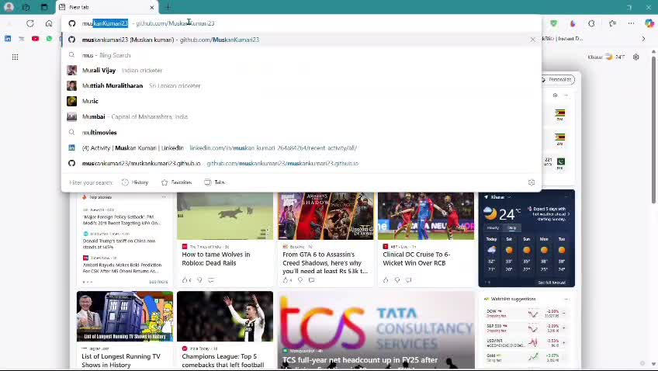
Result
1
The project proves how algorithmic logic can be applied in a real-life financial planning tool through a clean and functional frontend application.
2
3
4
5
6
7

Slide 8
1
2
3
4
Thank you
5
6
7

